Slide 1

MASTERS OF APPLIED COMPUTING
UNIVERSITY OF WINDSOR
AirBnb New User Booking, Kaggle Competition
Machine Learning & Pattern recognition (COMP-8740)
Instructor : Dr. Robin Gras

Slide 2
Table of Contents
Introduction
Background
Problem statement
Role of Machine Learning
Our Solution
Data Analysis
Data Preprocessing
Feature Selection
Dimensionality reduction
Handling Imbalanced data
Methodology
Random Forest
Ridge regression
Decision Tree
Extra trees classification
Gradient Boosting Classification
Evaluation
Conclusion
Future Work
References

Slide 3
Background
Airbnb has become a really prevalent choice among travellers around the world for the kind of unique experiences that they give additionally for presenting cheap, pocket-friendly staying options in more than 34000+cities over 190 nations.
The COVID-19 has impacted negatively on Airbnb, which has been one of the hardest hit platforms.
Users can make their bookings either through the site application or using the iOS/Android application. Airbnb is consistently attempting to improve the user’s first booking experience.

Slide 4
Problem Statement
In this challenge, we are provided a list of people, their demographics, web session logs, and some summary statistics. We need to anticipate which countries a new user would travel to for their first booking. The users in this dataset are all from the United States. There are 12 possible outcomes of the destination country: 'US', 'FR', 'CA', 'GB', 'ES', 'IT', 'PT', 'NL','DE', 'AU', 'NDF' (no destination found), and 'other'. The 'NDF' is different from 'other' because 'other' means there was a booking, but it is to a country not included in the list, while 'NDF' means there wasn't a booking.

Slide 5
Role of Machine Learning
With the essence of machine learning, the system can be designed which will accurately predict where the user will book for the first time and subsequently decrease the average booking time and improvise the booking experience. Airbnb can meaningfully utilize it to better personalize their marketing tactics and increase its booking rates.

Slide 6
Our Solution
To begin with, we analyze the dataset by visualizing different features. We perform data cleaning and preprocessing by imputing missing values and outliers. Then, feature selection is done by plotting the correlation graph and dimensionality is reduced using Principal Component Analysis (PCA). For model selection, we utilize supervised learning algorithms. Based on imbalance in data, we perform resampling of the dataset. We select five models based on different factors then analyze and compare the performances of each of these algorithms. We optimize these algorithms by tuning their hyper parameters and evaluate the performance using f1 score and confusion matrix.

Slide 7
Data Analysis
This airbnb dataset is featured in the Kaggle competition for the New User Bookings competition. It includes 5 datasets to help with the prediction of the travel destination country.
This dataset includes information like demographics of specified countries, users web session records and some summary statistics.
All information is captured in five files:
Train_users.csv
Test_users.csv
Sessions.csv
Countries.csv
Age_gender_bkts.csv

Slide 8
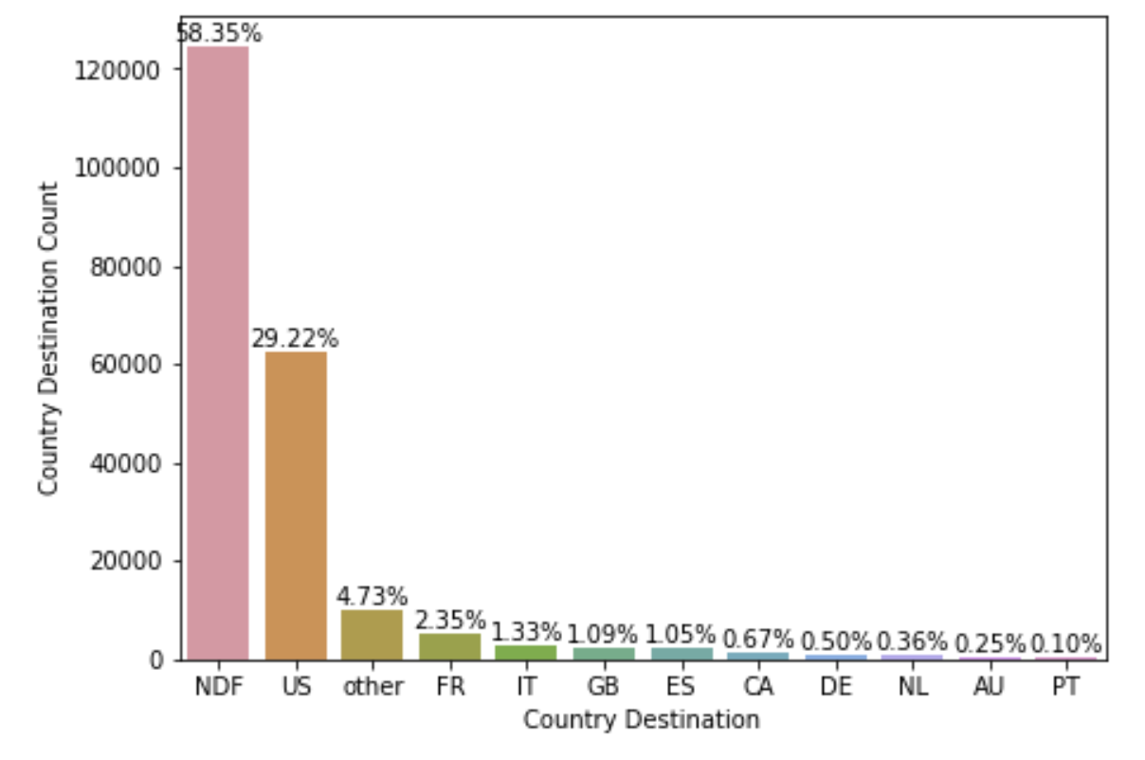
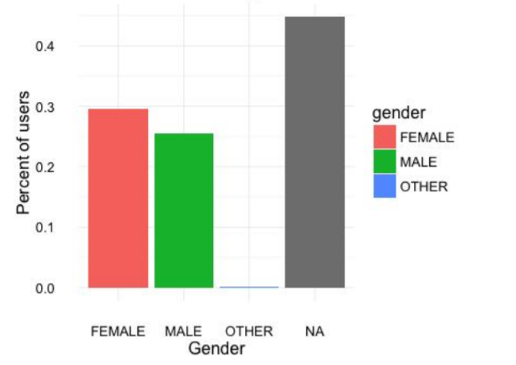
Figure 1 Distribution of destination countries
Figure 2 Distribution of gender

Slide 9
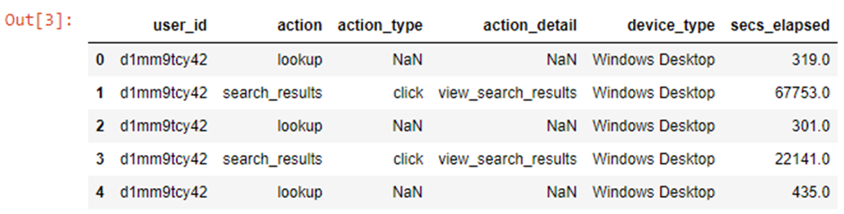
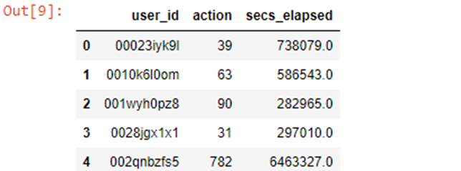
Data Pruning
Data Pruning is one of the techniques used for removing unused parameters to solve overfitting problems.
The session_csv dataset has 6 columns user_id, action, action_type, action_detail, device_type and secs_elapsed. We aggregate action_detail and action_type for each user.
Figure 3 sessions.csv before pruning
Figure 4 sessions.csv before pruning

Slide 10
In the sessions.csv dataset, there are a lot of repetitive users with different actions. We aggregated the actions by counting all actions a user performed and store that by mapping to user id. Lastly, we filled the missing values in session.csv with -1.
Data | Users | Features
Dataset before pruning | 10567737 | 6
Dataset after pruning | 135483 | 3
Table 1: Sessions Dataset Information

Slide 11
Data Cleaning and Preprocessing
Data cleaning is the process of identifying and correcting errors in a dataset that may have a negative impact on the model. Data cleaning involves cleaning the null values and outliers from the dataset. The following steps are performed in cleaning the dataset.
Merged session dataset with training and testing dataset using user id
Filled missing values with data
Changed date format
Removed Outliers
We first merge the user details and sessions dataset to create one dataset by mapping them using user id. We then proceed with data cleaning and preprocessing.

Slide 12
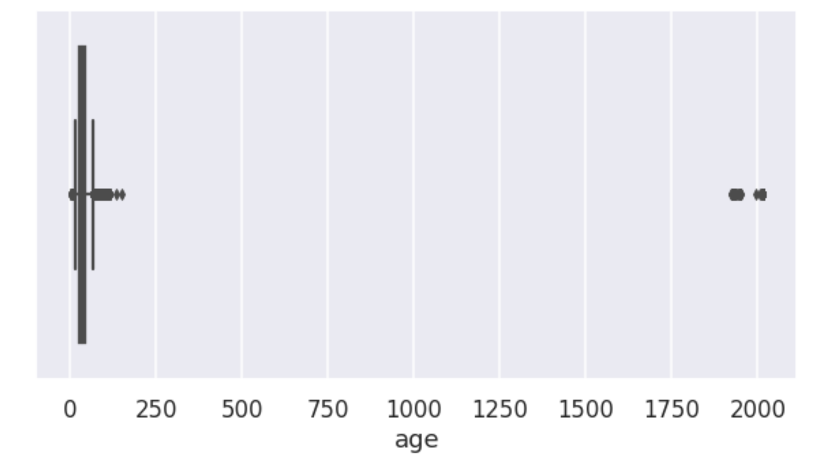
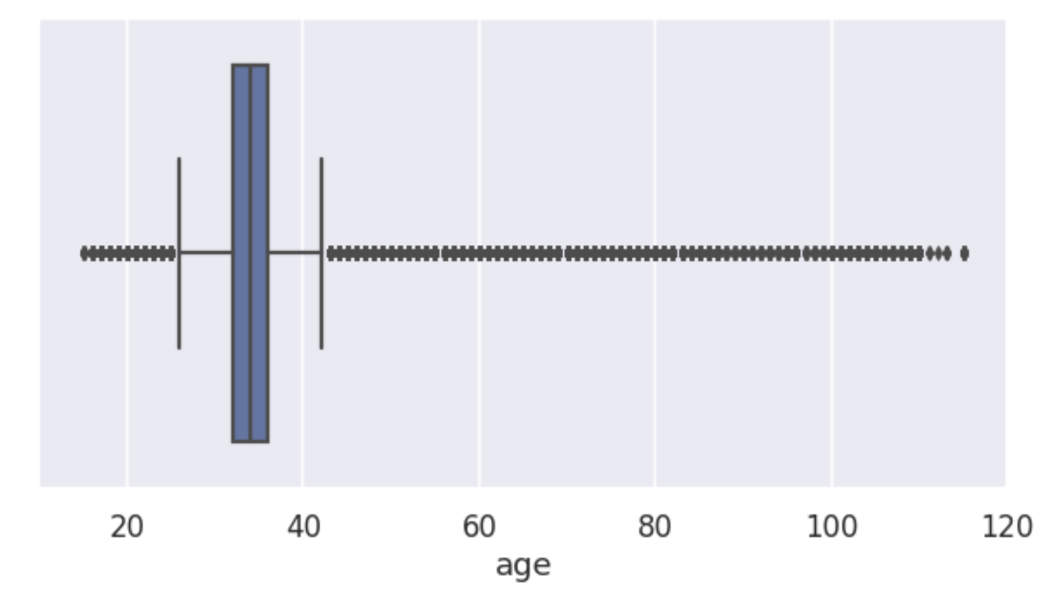
Removed Outliers
Outliers increase the variability in the dataset, which decreases statistical power. Consequently, excluding outliers can cause the results to become statistically significant.
Filled missing values with data
Firstly, cleaning a dataset includes filling or replacing missing values. Missing values in the dataset are by default represented as NaN (Not a number). To fill null values in the columns of secs_elapsed, action and action_type columns, we have used -1.
Changed date format
We have three different fields in the user datasets that contain data on different dates: date_account_created, timestamp_first_active, and date_first_booking. We will simply remove the date_first_booking field as it has 58% null values. We separated year, month, and date for timestamp_first_active and date_account_created.
Figure 5 Age with outliers
Figure 6 Age without outliers

Slide 13
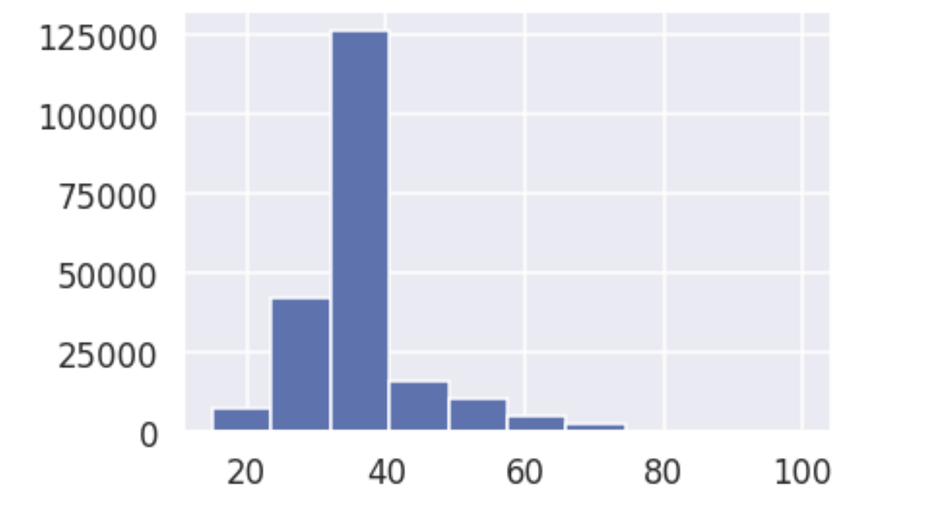
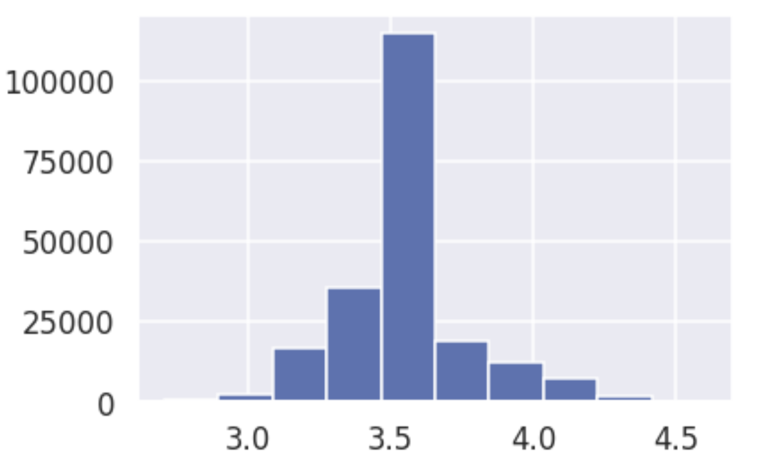
Data Preprocessing
Data preprocessing is an essential step in Machine Learning because the quality of data and the useful information that can be extracted from it directly affects our model's ability to learn and thus, it is critical that we preprocess our data before feeding it into the model
Checked skewness in age:
The data is positively skewed or skewed right if the skewness is positive. When skewness is negative, the data is negatively skewed or skewed left. When skewness equals zero, the data are perfectly symmetrical. Many statistical models fail when there is too much skewness in the data. We check skewness for age:
Initial skewness: 1.94737023 (right skewness)
Removed skewness with applying log(age).
Skew after correction: 0.52898
Figure 7 Right skewed data of age
Figure 8 Removing skewness by taking log(age

Slide 14
Feature Selection
We perform feature selection for three reasons:
To minimize overfitting - With less redundant data, there is less chance of making decisions based on noise.
To increase Accuracy - Less deceptive data gives better results.
Reduce training time - Lesser data means less time for analysis.

Slide 15
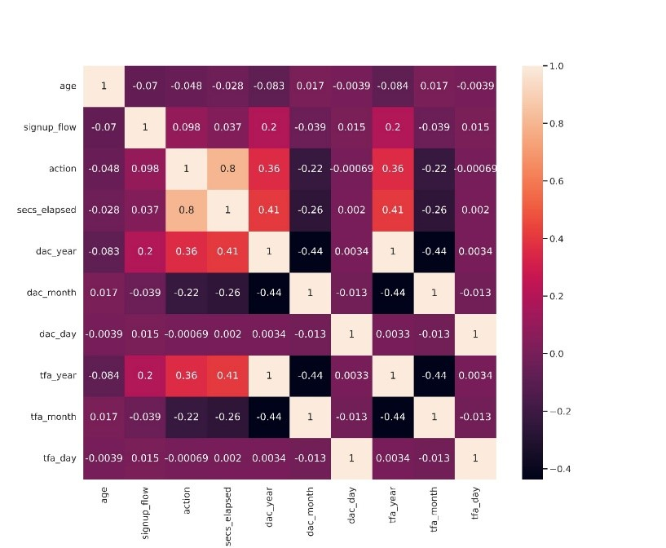
Correlation Matrix
Correlation matrix describes how two or more variables are related to one another. These variables could be input data features that were used to forecast our target variable.We can anticipate one from the other if two variables are significantly correlated.
There is a high correlation between dac_year, dac_month, dac_day and tfa_year, tfa_month and tfa_day respectively, along with action and second elapsed. We, therefore, remove the secs_elapsed, tfa_year, tfa_month and tfa_day to reduce correlation.
We divide the entire data frame into two datasets: 80% for training and 20% for testing.
Figure 9 Correlation matrix

Slide 16
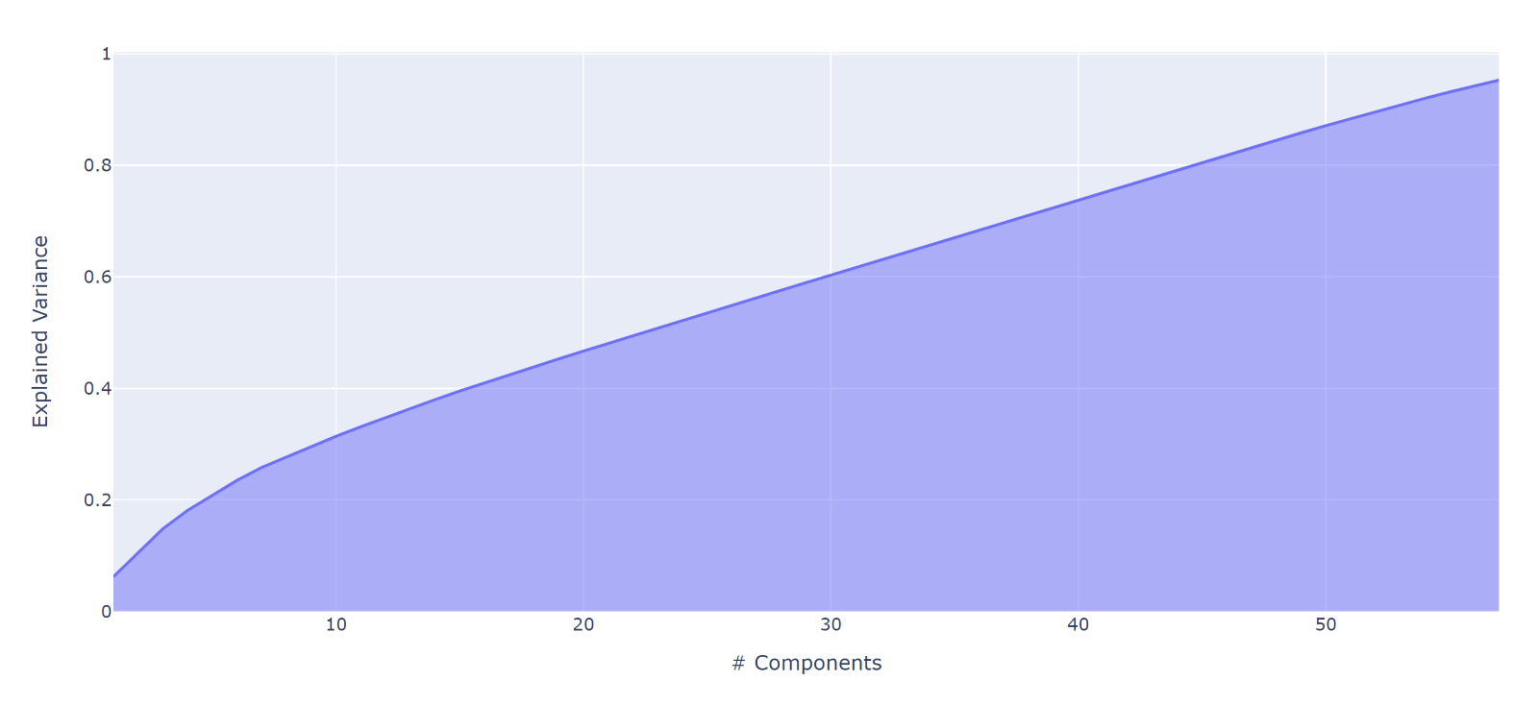
Dimensionality Reduction
For dimensionality reduction, we employ Principal Component Analysis (PCA). It's a technique that involves projecting each data point onto only the first few principal components in order to obtain lower-dimensional data with as little fluctuation as feasible. In our data, to capture 0.9529 variance, 57 principal components are used.
Handling imbalanced data
In this dataset, the maximum examples are for ‘NDF’ and ‘US’ as destination countries. We first use SMOTE to generate synthetic examples of minority classes to ensure class balance. SMOTE first selects a minority class instance at random and finds its k nearest minority class neighbors.
This approach aids in overcoming the problem of overfitting caused by random oversampling. It performs better than random oversampling as random oversampling chooses random samples from the minority class and replaces them in the training dataset.
We combine SMOTE with random under sampling to reduce the samples of the majority class,
We compare the performance of ridge algorithm and random forest models before and after resampling the data. The results are discussed in further sections.
Figure 10 Variation in variance of data with increasing number of Principal components

Slide 17
Handling Imbalanced Data
In this dataset, the maximum examples are for ‘NDF’ and ‘US’ as destination countries. These majority classes can lead to the low performance of the models.
We combine SMOTE with random undersampling to reduce the samples of the majority class, i.e. ‘NDF’. Random undersampling reduces the number of examples in the training dataset.
We first use SMOTE to generate synthetic examples of minority classes to ensure class balance. Then we add Random under sampler to reduce the number of examples in the training dataset.

Slide 18
Methodology

Slide 19
Random Forest
Random forest is an ensemble algorithm that generates different training subsets from sample training data with replacement and builds decision trees on these samples.
We choose a weighted f1 score for comparison as it accounts for class imbalance by computing the average of binary metrics in which each class’s score is weighted by its presence in the true data sample.
First, we implement this algorithm without sampling the data. In the second scenario, we perform sampling of the data by combining Synthetic Minority Oversampling Technique (SMOTE) and Random Under Sampling to synthesize new examples from existing examples of the minority class and reduce the examples of the majority class.

Slide 20
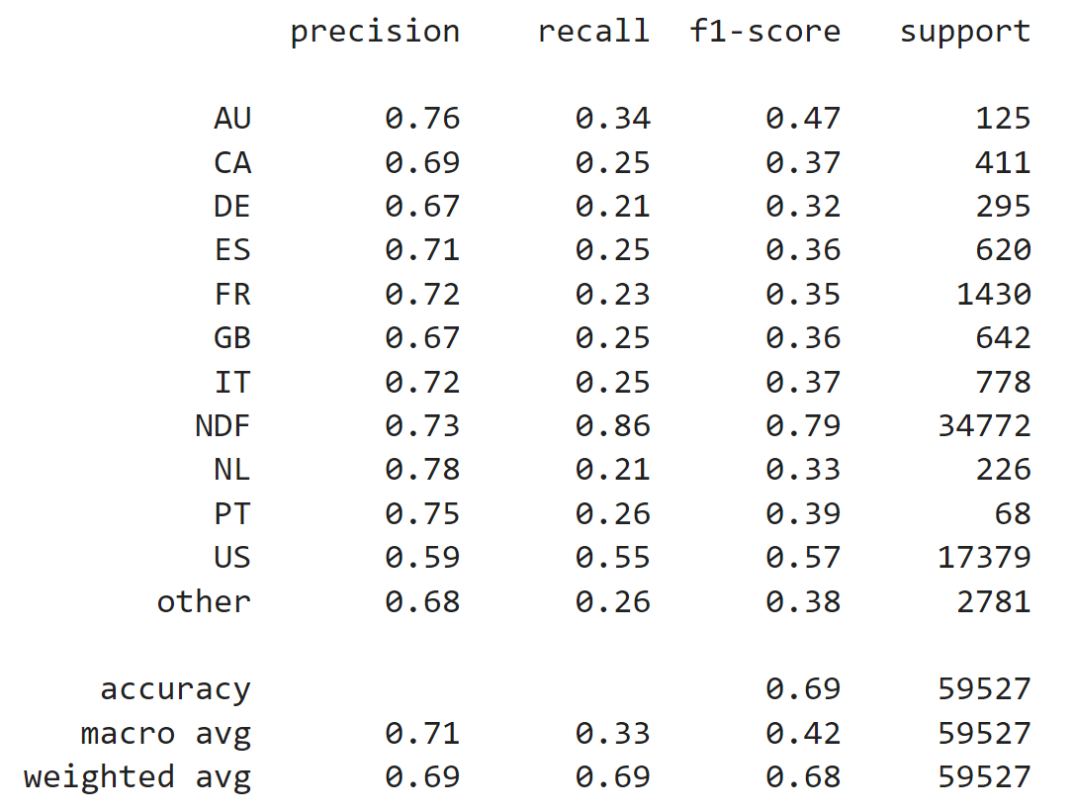
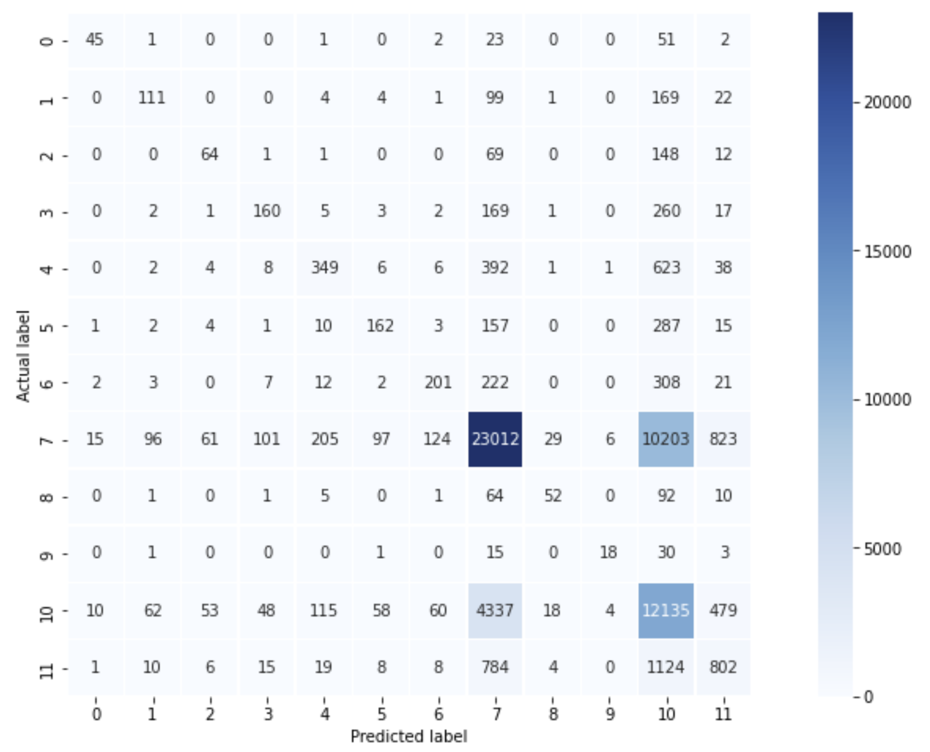
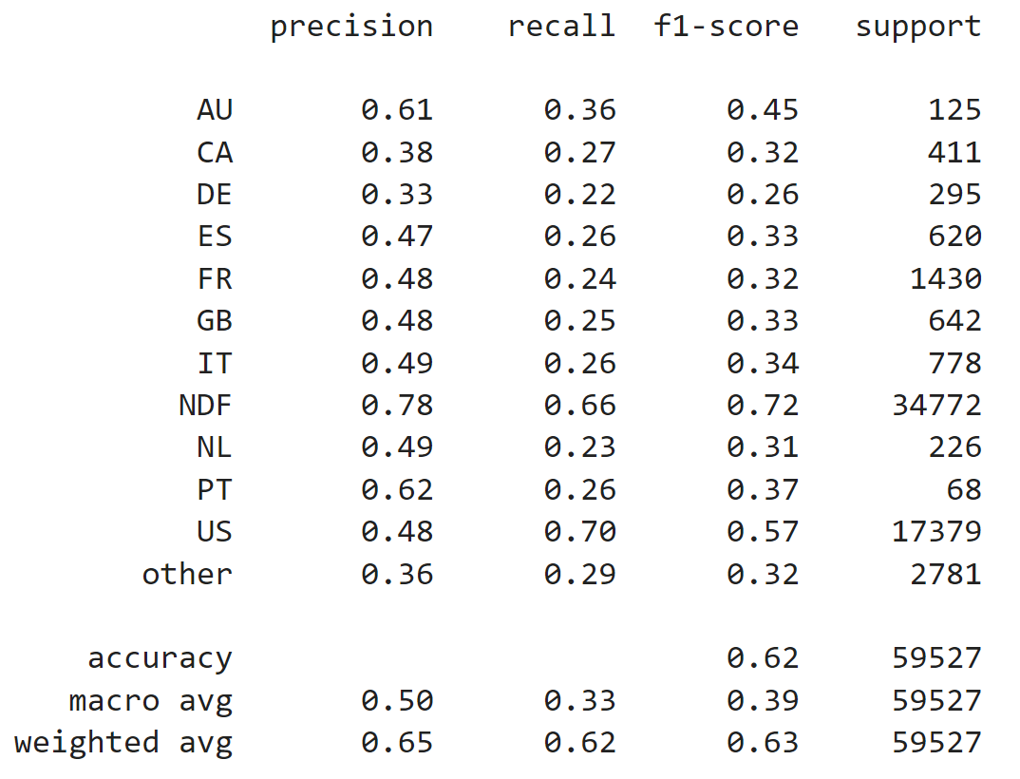
Figure 11 Random Forest Classification report (before sampling)
Figure 13 Random Forest Confusion matrix with resampled data
Figure 12 Random Forest Classification report (After sampling)

Slide 21
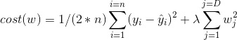
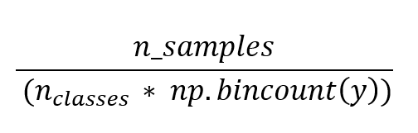
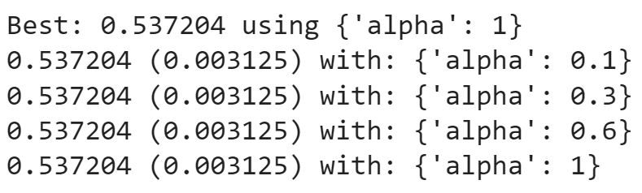
Ridge Regression
Linear regression minimizes the loss function by selecting coefficients for each independent variable. However, if the coefficients are excessively large, it may overfit the training dataset and lead to model overfitting.
First, we implement the ridge algorithm on training data without any resampling. Next, we apply the ridge algorithm after resampling the data using SMOTE and random under sampling. We use the value of alpha as 0.01, 0.1 , 0.5 , 0.8 , and 1 and choose the class weights as balanced as it automatically adjusts weights which are inversely proportional to class frequencies in the input data as
We evaluate the performance based on weighted f1 score. The results of model performance with different values of alpha are summarized in the diagram below.

Slide 22
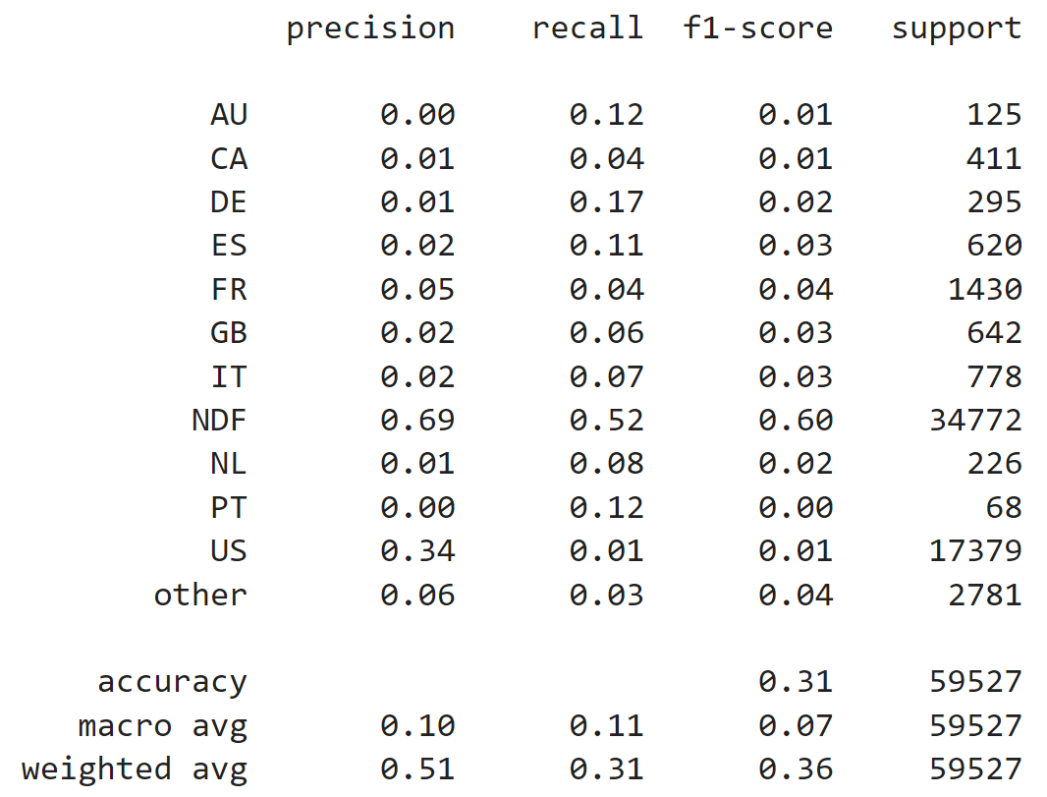
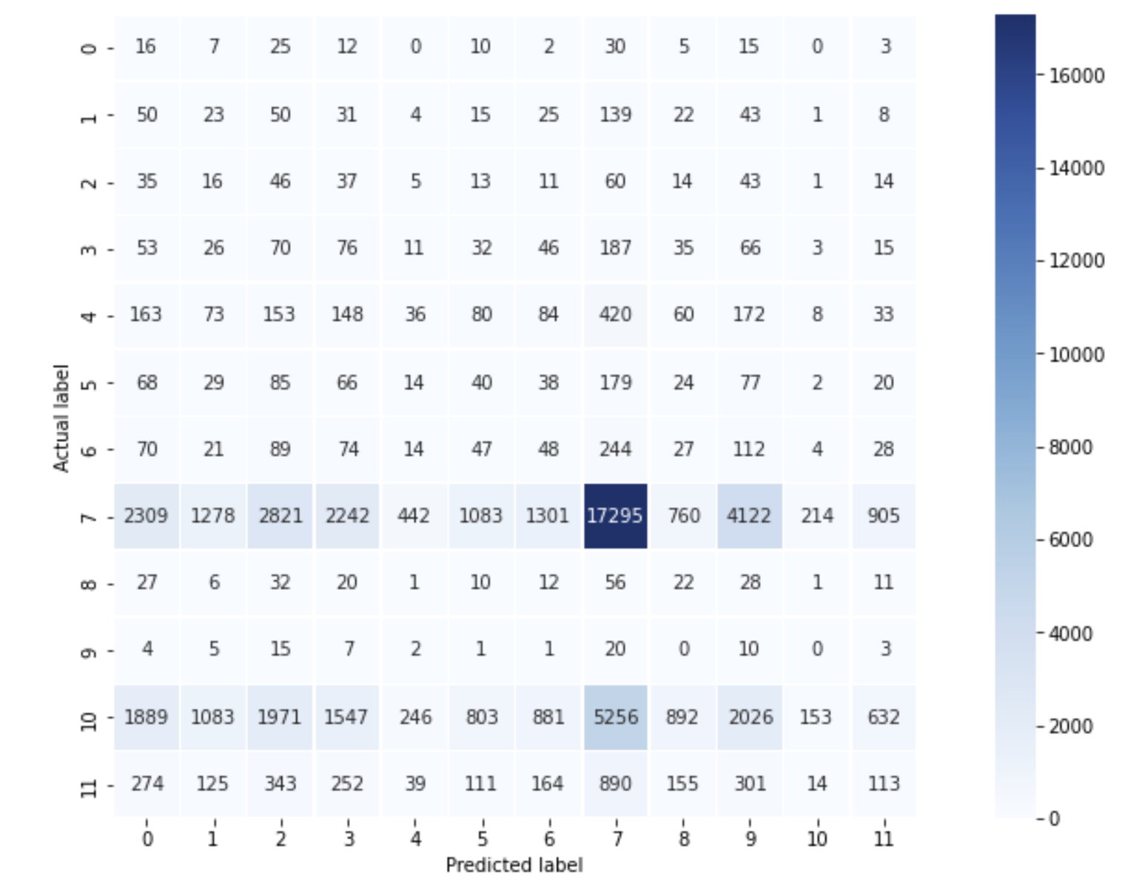
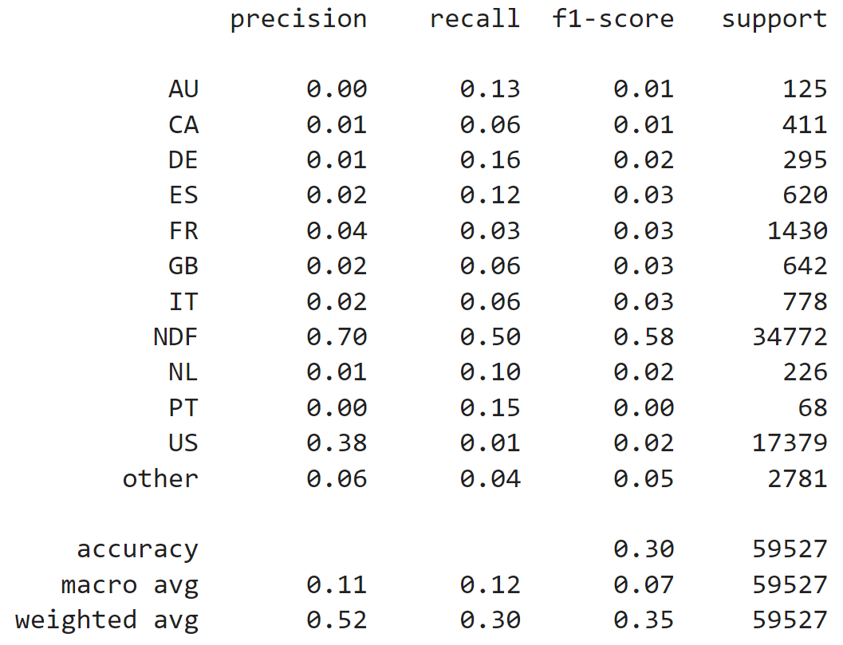
Figure 14 Ridge Algorithm Classification report (before resampling)
Figure 16 Confusion matrix of Ridge Regression after resampling data
Figure 15 Ridge Regression Classification report (after resampling)

Slide 23
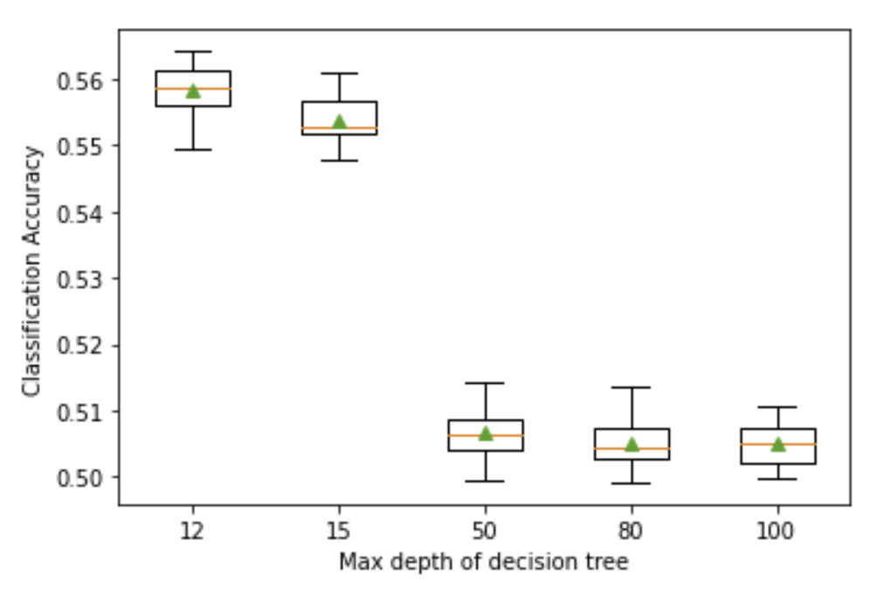
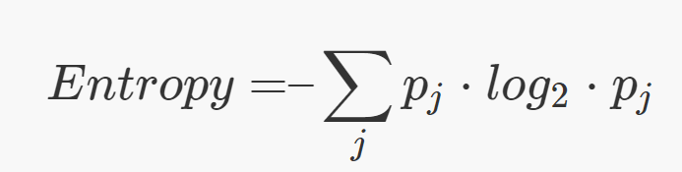
Decision Tree
Decision Tree generates a training model that can be used to predict the class or value of the target variable.
The hyperparameters for this model are follows:
Max depth: This indicates the depth of the tree. The deeper the tree, the more splits it has and it captures more information about the data. Keeping other parameters default, we tune the model for depths 12,15,50,80, and 100. By plotting the box and whisker plots as well, performance is found optimal for depth set to 12
Criterion: It decides which attribute to place at the root or at internal nodes. Supported criteria are “gini” for the Gini impurity and “entropy” for the information gain. Keeping depth as 12, we find that our model performs better for entropy.
Fig 17. Box and whisker graph of effect of max depth of decision tree vs its evaluation score

Slide 24
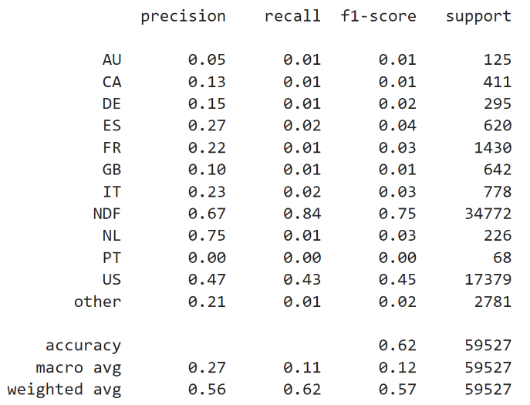
Fig 18. Decision Tree Classification report

Slide 25
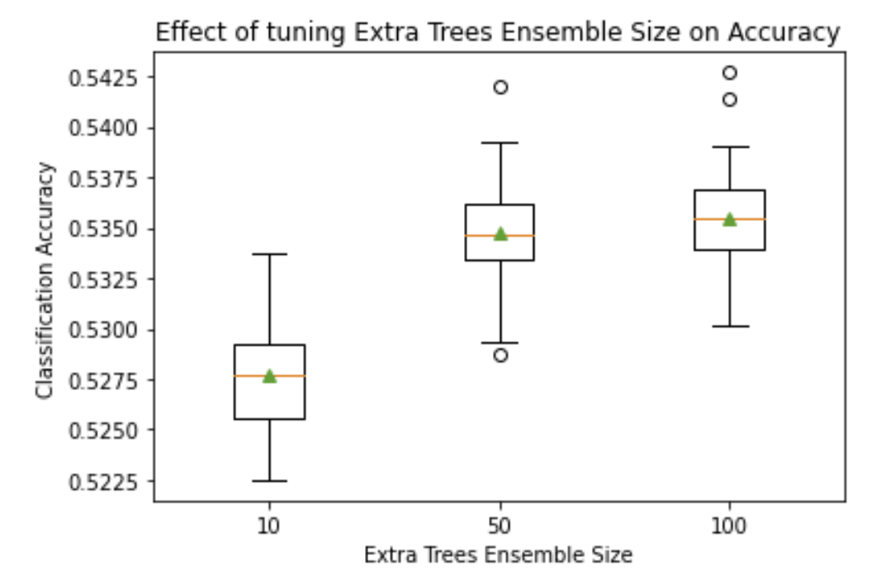
Extra Trees Classifier
Ensemble size | Average Weighted F1 score
>10 | 0.528
>50 | 0.535
>100 | 0.535
Table 3 Evaluation of F1 score by changing number of trees in extra trees algorithm, other parameters set to default
Extra Trees Classification is short for Extremely Randomized Trees and is a variation of random forest algorithm. It is computationally faster than random forest.
For optimizing the results, we tune the following hyperparameters in this algorithm. We choose weighted f1 score for comparison.
1. The number of trees: This parameter decides the maximum number of trees to be used in the ensemble. We change the maximum number of trees to 10, 50 and 100 and summarize the results as shown in Table 1. The performance is found to be most stable when the value of maximum trees is set to 50. The following table depicts the effect of changing the number of trees in the ensemble based on the f1 score.
Fig 19. Box and whisker graph of number of effect of trees in extra trees ensemble vs its evaluation score

Slide 26
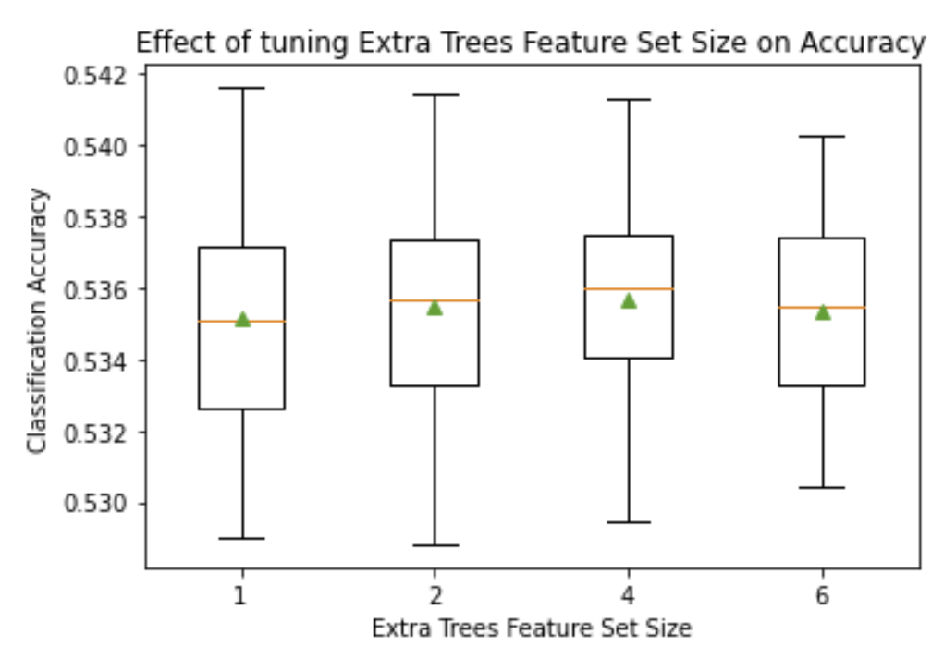
Max features | Average weighted f1 score
>1 | 0.535
>2 | 0.536
>4 | 0.536
>6 | 0.535
This parameter controls the maximum number of features to consider when looking for the best split. Keeping number of trees set to 50, we set the value of max features as 1, 2 and 4 to compare the performance of the model based on f1 scores. Performance is found to be optimal when maximum number of features is set to 4.
Table 4 Evaluation of F1 score by changing max features in extra trees ensemble, other parameters set to default
Fig 20. Box and whisker graph of feature set of varying feature size of extra trees vs its evaluation score

Slide 27
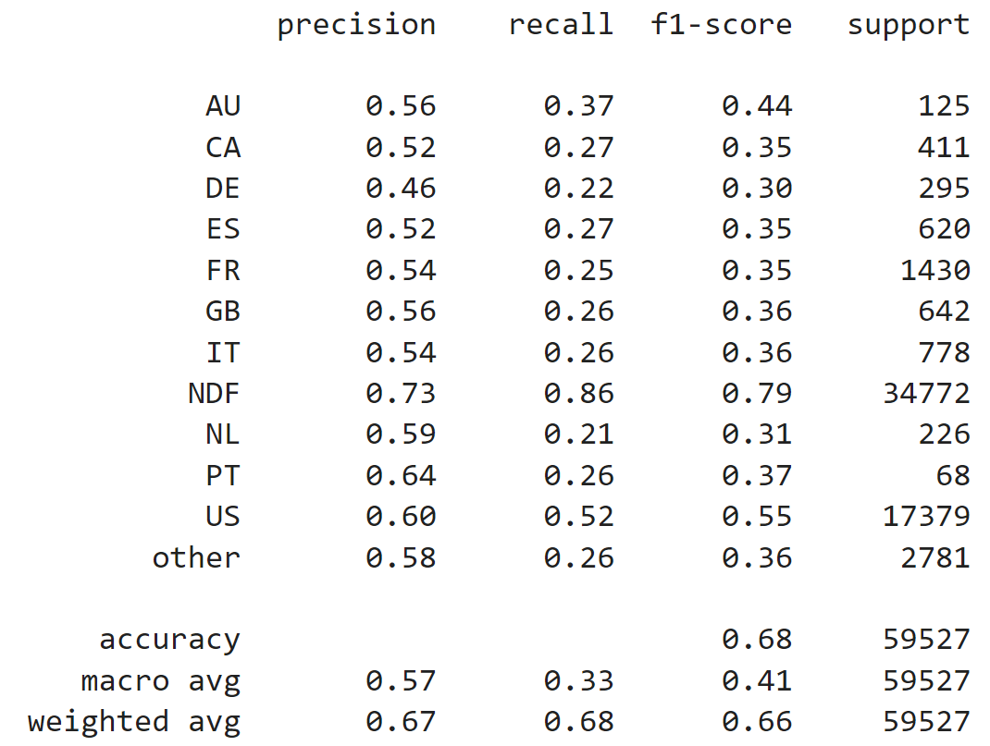
Fig 21. Extra tree classifier Classification Report

Slide 28
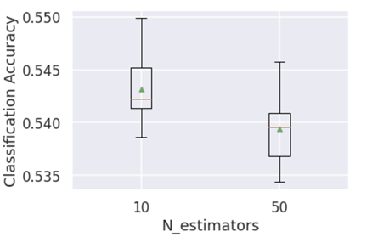
Gradient Boosting Classifier
Gradient Boosting is a type of ensemble machine learning algorithm. This type of algorithm builds a strong model by aggregating a collection of weaker models. We have implemented the most popular Xgboost algorithm, which stands for Extreme Gradient Boosting.
1. N estimators: This parameter controls the number of boosting stages to perform. Keeping the other parameters as default, we tune the n_estimates parameter to 10, and 50 and evaluate the model performance. The optimal performance is viewed at 10 trees.
2. Learning rate: The learning rate determines how much each model contributes to the ensemble prediction. Smaller rates may need the inclusion of more decision trees in the ensemble. Setting the number of trees to 50, we explore the learning rate between 0.01 to 1. The optimal performance is found when learning rate is set to 0.01 as summarized in table below.
Fig 22. Decision Tree Classification report
Learning Rate | Average weighted F1 score
0.01 | 0.545
0.1 | 0.543
0.3 | 0.537
0.5 | 0.545
Table 5. Evaluation of performance of XGBoost algorithm with varying learning rate

Slide 29
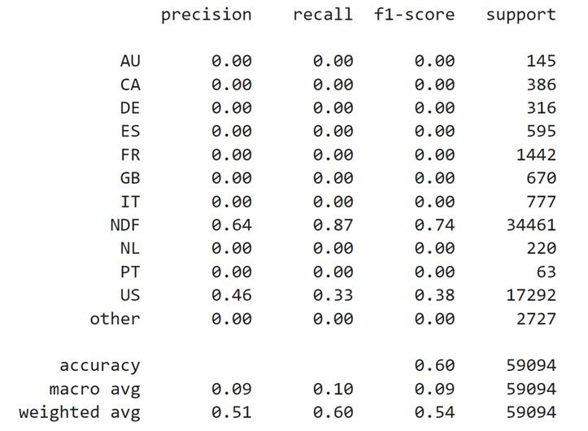
Fig 23. Classification report of xgboost algorithm

Slide 30
Evaluation

Slide 31
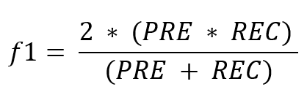
Result
For evaluation we analyze the performance of all the models on the test data based on precision, recall and f1 score. We also create a confusion matrix for each of them to understand their performance better.
The goal of the F1-score measure is to balance between precision and recall, which is particularly useful in situations when dealing with unbalanced datasets
where PRE stands for precision and REC stands for recall.
We find that the best performance is given by random forest and extra trees classifier, but we propose to utilize extra trees classifier as it is computationally faster.

Slide 32
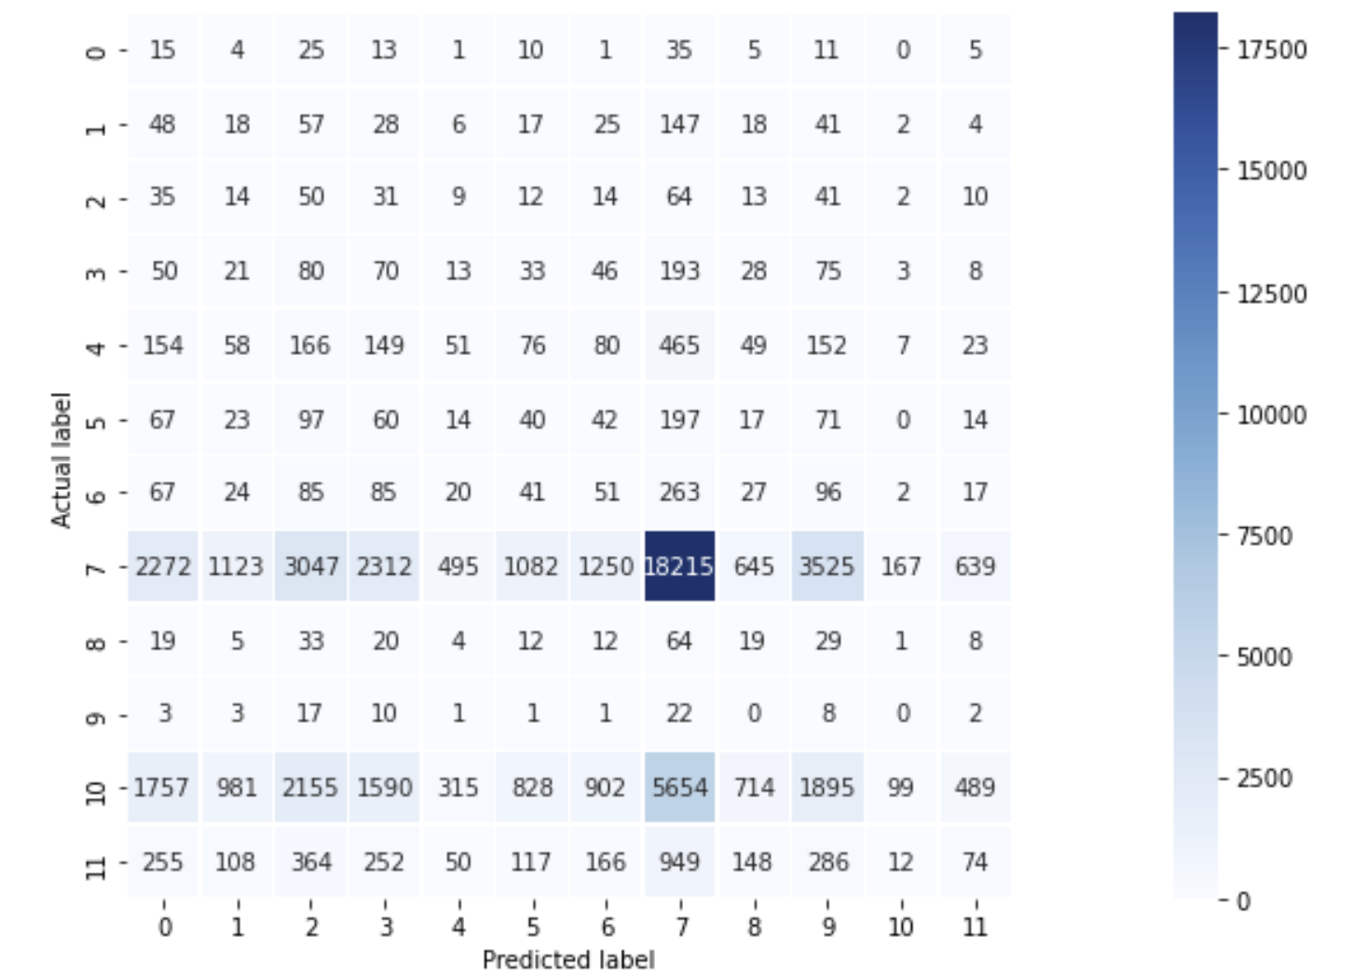
Fig 24. Confusion matrix for Ridge Algorithm

Slide 33
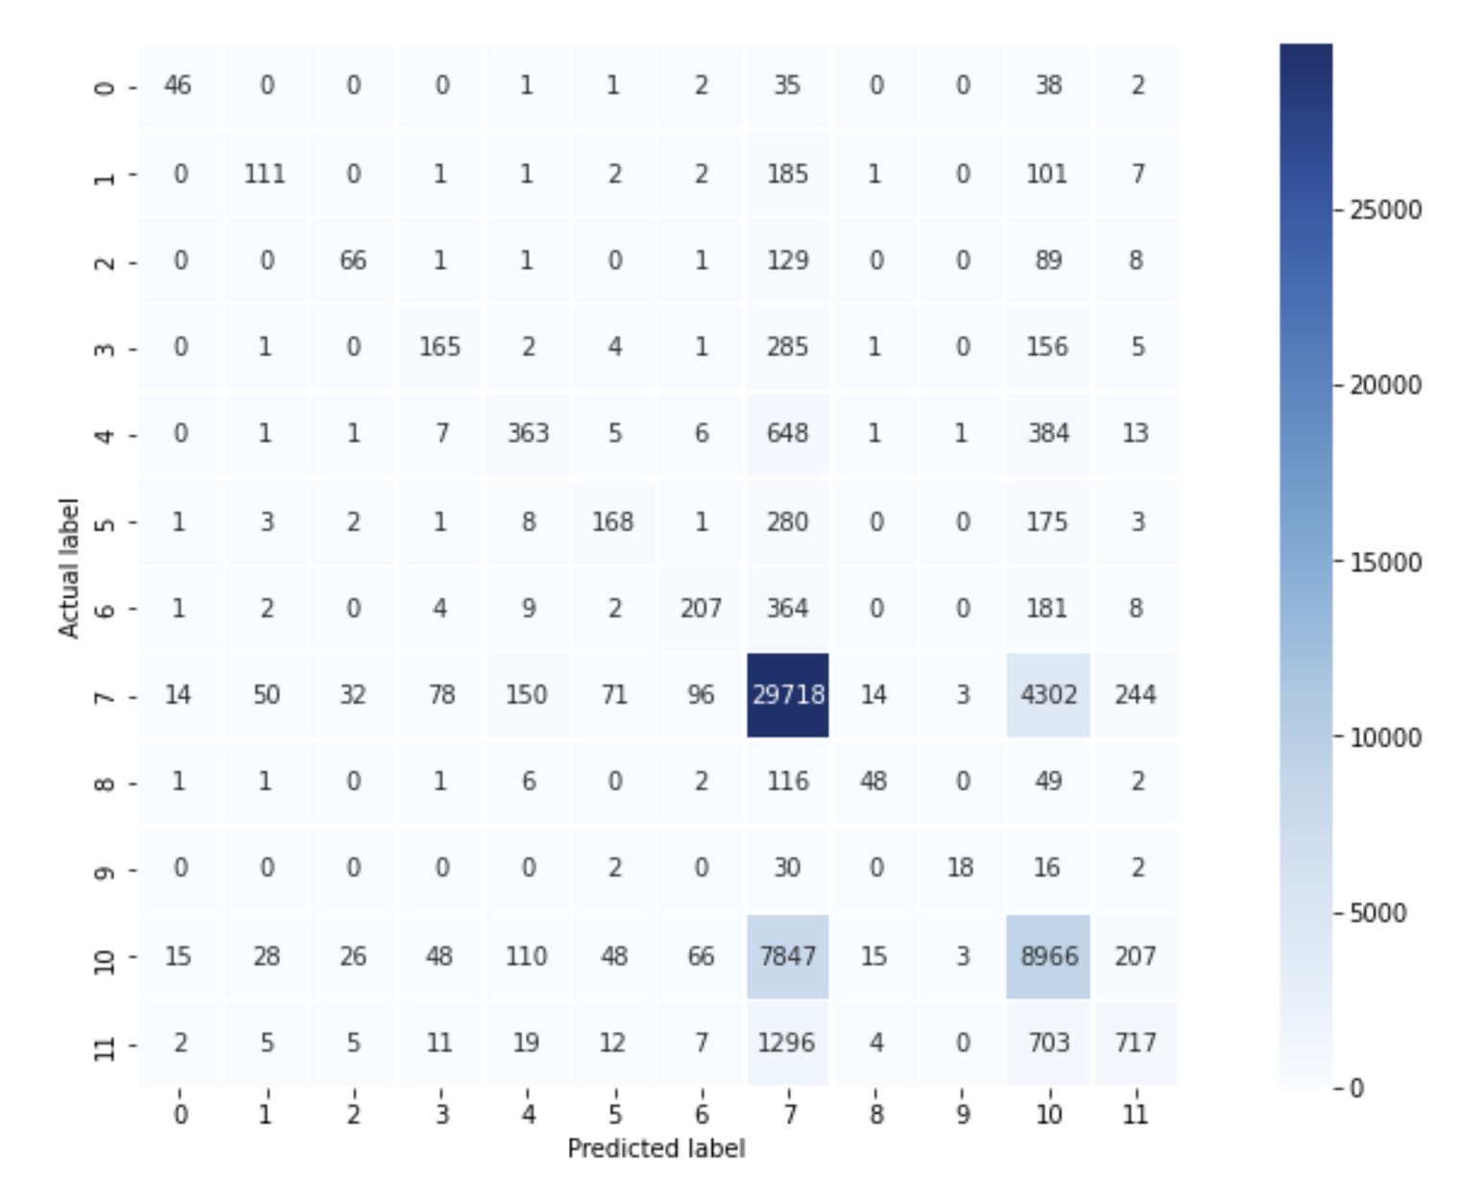
Fig 25. Confusion matrix for Extra trees

Slide 34
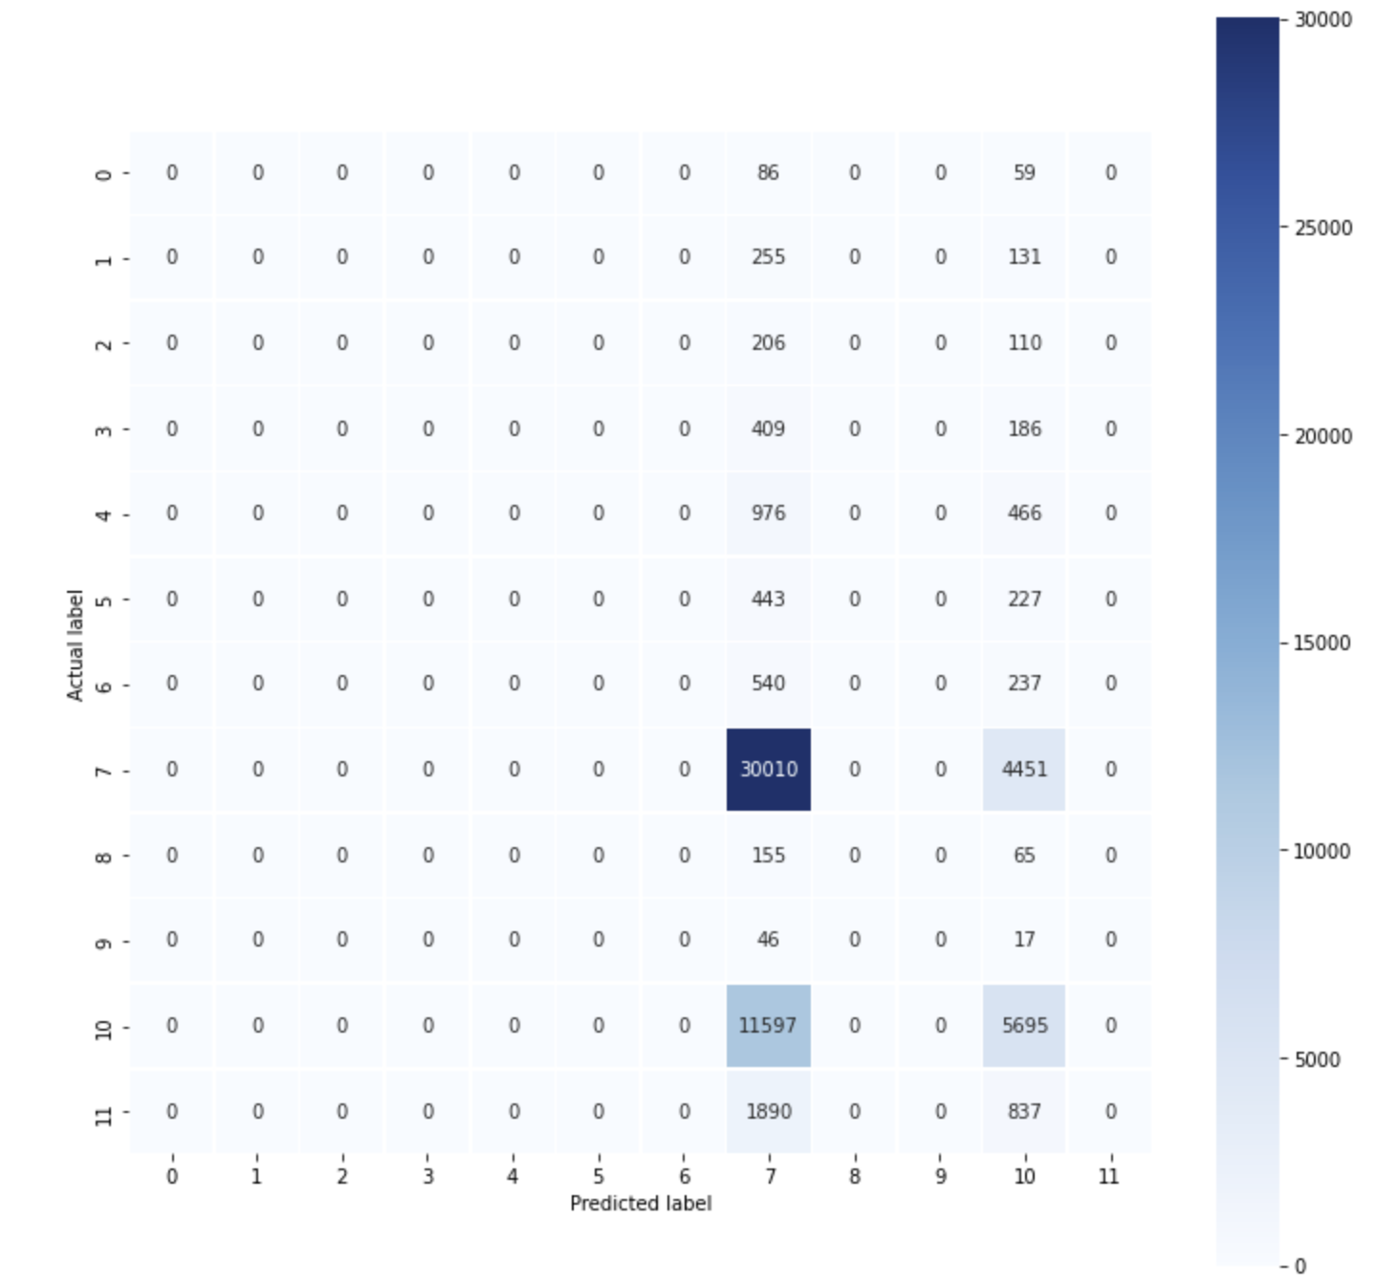
Fig 26. Confusion matrix for XGBoost

Slide 35
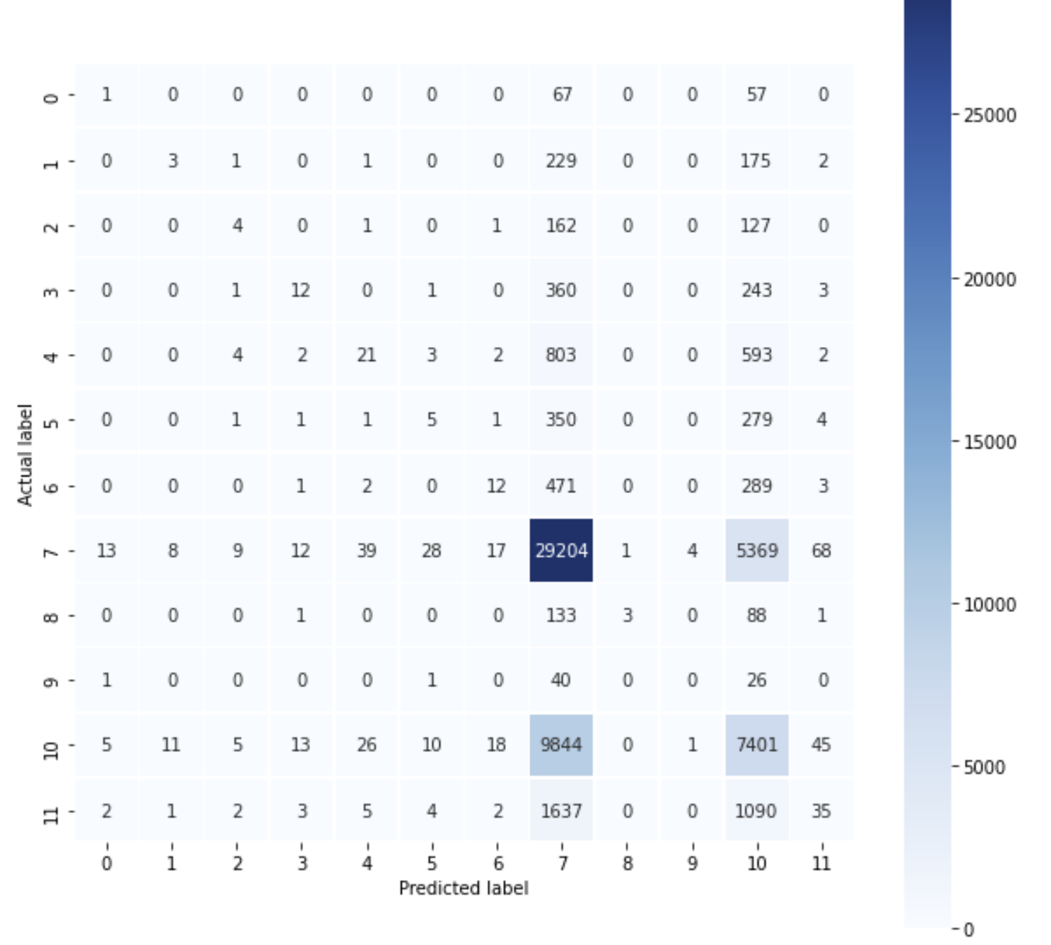
Fig 27. Confusion matrix for Decision trees

Slide 36
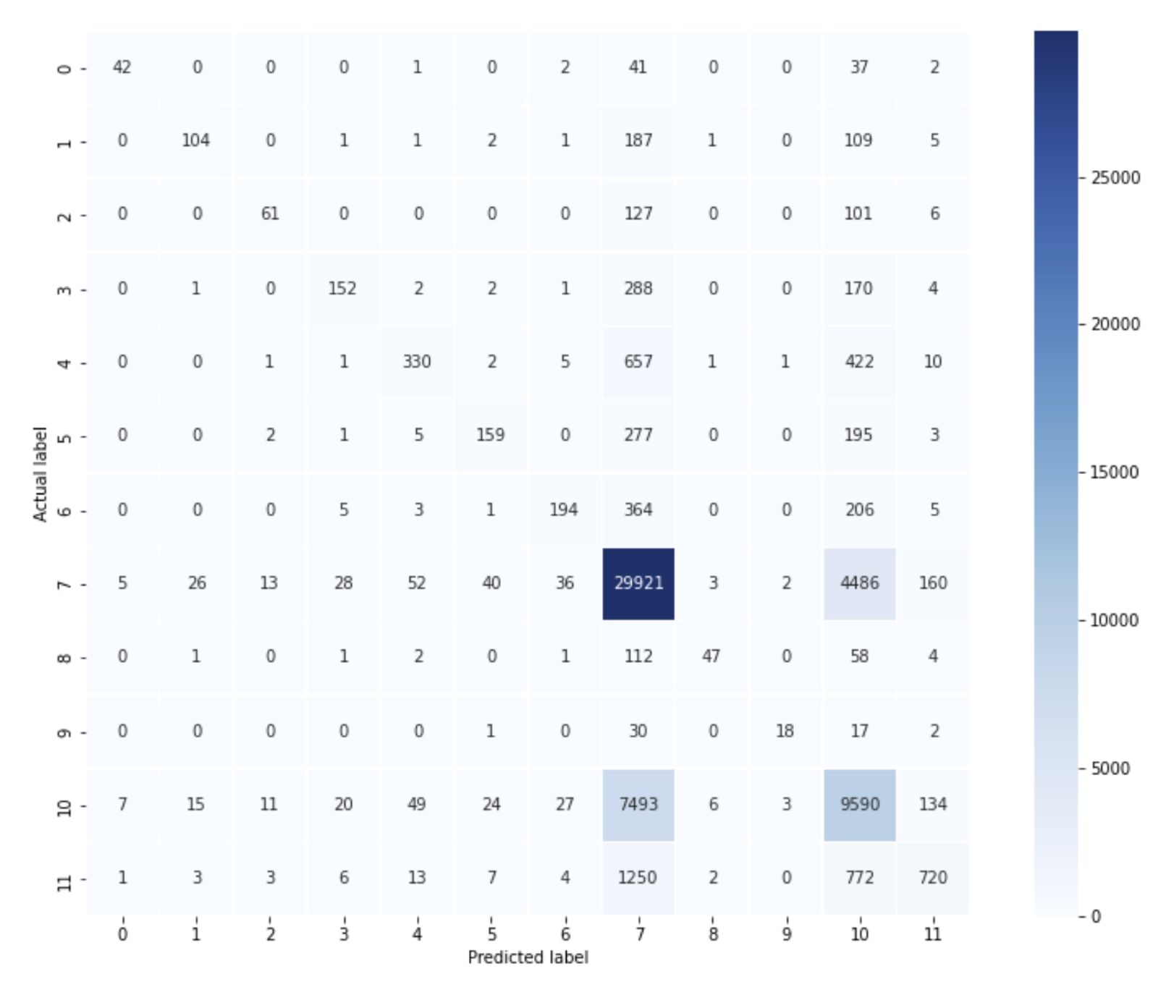
Fig 28. Confusion matrix for Random forest

Slide 37
Algorithm | Weighted F1 score
Random forest without resmapling data | 0.675
Random forest with resmapled data | 0.625
Decision tree | 0.57
Ridge algorithm without resampling data | 0.536
Ridge algorithm with resampled data | 0.354
XGBoost algorithm | 0.54
Extra trees algorithm | 0.664
Table 6 Evaluation of performance of different classification algorithms

Slide 38
Conclusion
We finalize to utilize (model name) in our case as it performs best on the test dataset with a highest value of (scores). We have compared the models by plotting the confusion matrix and made the comparison to find the best one. This helped a lot in the prediction task to find the destination country for the new user’s booking at AirBnb.

Slide 39
References
[1] Geurts, P., Ernst, D. & Wehenkel, L. “Extremely randomized trees”. Mach Learn 63, 3–42, 2006.
[2] Hugo Ulfsson “Predicting Airbnb user's desired travel destinations”, Stockholm, 2017.
[3]Srinivas Avireddy, Sathya Narayanan Ramamirtham, Sridhar Srinivasa Subramanian “Predicting Airbnb user destination using user demographic and session information”, UC San Diego
[4] H. He, Y. Ma, ”Imbalanced Learning: Foundations, Algorithms, and Applications”, 2013.
[5] Airbnb Revenue and Usage Statistics (2021)
https://www.businessofapps.com/data/airbnb-statistics/
[6] Kaggle competition https://www.kaggle.com/c/airbnb-recruiting-new-user-bookings/overview
[7] Airbnb Revenue Image
https://infogram.com/airbnb-revenue-1hxr4zx9plzdo6y
[8] Kaggle competition
https://www.kaggle.com/manas13/airbnb-new-user-bookings
[9] Kaggle competition
https://www.kaggle.com/justk1/airbnb
[11] Kevin P. Murphy, Machine Learning: A Probabilistic Perspective, 2012.
[12]https://scikit-learn.org/stable/modules/generated/sklearn.linear_model.RidgeClassifier.html

Slide 40
Future Work
Most of the accommodation results are either NDF(No destination found) or US. More data for individual user’s web activities should be collected that will surely be useful to improve the accuracy of the prediction. Hyperparameter tuning of the various other different parameters can be performed. The session data and training data can be more utilized by extracting, improvising more features.

Slide 41

Thanks!
MEHER JYOTHI KARPURAPU
STUDENT ID (110070739)
karpura@uwindsor.ca
JANANI SURESH KUMAR
STUDENT ID (110071944)
sureshkj@uwindsor.ca
NIKHILESH .
STUDENT ID (110057906)
nikhile@uwindsor.ca

